Slide 1
The Beat Goes On-Athon
Preconference
Music Library Association Annual Meeting
Orlando, FL
Feb. 22, 2017
Kathy Glennan
Head, Monographs & Music Cataloging University of Maryland

Slide 2
Setting Up
Connect to the wireless
Network name: ___
Password: ___
Follow the handout instructions:
Make sure you have the latest version of RIMMF (170205)
Set your unique RIMMF prefix
Create a new data folder
Open the preconference wiki

Slide 3
Introductions and Thanks
Organizer / Instructor
Kathy Glennan, ALA Representative, RDA Steering Committee
Consultant
Tracey Snyder, MLA Cataloging and Metadata Committee Chair
Coaches
Kristi Bergland, University of Minnesota
Jean Harden, University of North Texas
Karen Peters, Bates College
Moral support and additional planning guidance
Lisa Hooper, MLA Education Committee Chair
Molly O’Brien, MOUG Continuing Education Coordinator
Diane Steinhaus, MLA Convention Manager

Slide 4
Schedule
8:30-9:00am
Getting started
9:00am-12:30pm
12:30-1:30pm
Lunch
On your own
Create RIMMF records
Welcome, Introductions, Overview
9:45-10:00am: Coffee break upstairs – thanks to MOUG!
1:30-2:30pm
Wrap up discussion
RDA / RIMMF / Linked data / Q&A

Slide 5
RIMMF Reminders
Tools & guidance on RIMMF website http://www.marcofquality.com/wiki/rimmf3
User guide
Most commonly needed functions
Today, think “in RDA” not “in MARC”
Apply RDA as written
Don’t take MARC-based shortcuts
Not obliged to use LC-PCC Policy Statements or MLA Best Practices
Notes:
Those who don’t need a quick review can just get started

Slide 6
About RIMMF
Designed as a training / visualization tool
Enables seeing RDA in a new way
Promotes greater understanding of the FRBR model
Helps catalogers identify gaps in RDA
Linked subjects limited to WEMI, PFC
Limited applicability to the “real world” of cataloging – at least for now

Slide 7
RIMMF Multilingual Support
To change from English language and labels
Options > Setup > Set language and labels
Choose your preferred language
For vocabulary terms and/or program language
Terms drawn from the RDA entries in the Open Metadata Registry

Slide 8
Have Fun!
Don’t agonize over making a perfect RDA record
This is a chance for you to explore a non-MARC way of capturing RDA data
If you run into problems, ask me or a coach for help
Document your questions, but also make a decision and move on

Slide 9
When to Restart RIMMF
If personal name dates aren’t displaying correctly in an AAP
Just the death date, even if the birth date should also be there?
If complicated relationships between works aren’t showing up in the R-Tree
Even though everything is linked correctly
Seeing anything else that strikes you as a strange display
If restarting doesn’t fix the problem, notify me or a coach

Slide 10
Data Entry in RIMMF
Enter or import data for each RDA entity (WEMI, PFC) and link the data appropriately
Templates support manual data entry
Pick the one that best matches what you’re creating
Can import legacy MARC bibliographic records

Slide 11
RIMMF Records from Scratch
Create Manifestation record
Create Work data
Start by clicking on “Expression manifested” in the Manifestation record
Create Person and Corporate body data for creator and contributor roles [or import these – see next slide]
Create Expression data
Start by clicking on “Expression of work” in the Work record
Check RIMMF’s autofills, updating as needed

Slide 12
Bringing in Authority Records
Check to see if there’s an existing authority record to import into RIMMF
Personal names, Corporate bodies, Works, Expressions
Use <F3> to search the NAF
Spacing, punctuation, and dates count
Odd results, or no results? Try a different way to search
Can always search by LCCN after finding the record at http://authorities.loc.gov

Slide 13
Importing MARC21 Records
<F3> in RIMMF searches LC’s catalog
LC’s OPAC has more sophisticated searching
http://catalog.loc.gov
Copy the LCCN and use that in a <F3> search
Use drag & drop to import MARC records from other sources – save as UTF-8 first
Sibley Music Library
http://catalog.lib.rochester.edu/vwebv
Yale University Library
http://orbis.library.yale.edu/vwebv/
OCLC – if you have institutional access
Export record to a local file; then import it into RIMMF

Slide 14
After Importing …
Check the resulting entity records
Move information that’s in the wrong record (some Manifestation data will really belong in an Expression record)
RIMMF’s MARC mapping is good, but not perfect
Make the labels for creators, contributors, etc. more specific
Add additional information as you see fit
May be “critical” if your source record is AACR2 or earlier

Slide 15
RIMMF Special Characters
Add diacritics
<Ctrl+Alt+D> and select from list
Add copyright or phonogram symbol
From Manifestation record:
Main Menu > Edit or
<Shift+F1> for ©
<Shift+F2> for ℗

Slide 16
Checking Your Work
Look at the list in the Entity Index (EI)
<Ctrl+E>
Review the “R-Tree”
A visualization of how your entities are linked to each other
Click on an entry to open and edit it

Slide 17
The Beat Goes On!

Slide 18
Some RIMMF Shortcut Keys
Basics
Entity index = Ctrl+E
RIMMF search tool = F3
Link to relationships = F5
Shortcut key list = Ctrl+K
Entity record display
Sort by element name = Ctrl+Alt+N
Sort by RDA number = Ctrl+Alt+R
Editing
Blank element = F4
Duplicate element name in new line = F2
Delete element = F11
Diacritic menu = Ctrl+D
© = Shift+F1
℗ = Shift+F2
Open record in different template = Ctrl+T
Restart ‘Build WEM’ = Ctrl+B

Slide 19
Entering Musical Flats, etc.
Press and hold down the Alt key
Press the + (plus) key on the numeric keypad
Type 266D
Release the Alt key
For sharp, in #3 substitute 266F
For natural, in #3 substitute 266E

Slide 20
Exporting your R-ball
Open the Entity Index <Ctrl+E>
Click the <Export> down arrow
Choose <Select all>
Click the <Export> down arrow again
Choose <Zip (Rimmf, ie. R-ball)>
Click <Export>
Add your prefix before the filename provided, e.g., bgoa_ei-export-170222
Click <OK> <OK>

Slide 21
Uploading your R-ball
Go to the preconference wiki page for R-ball uploads
Follow the instructions there to upload your file

Slide 22
Will return
LUNCH TIME!

Slide 23
Discussion Time
Summary of what you RIMMFed
Brief overview of RDA & linked data
Q&A

Slide 24
Today’s Records: Raw Entity Count
Work: 86
Expression: 81
Manifestation: 79
Person: 112
Corporate body: 13
Total: 371
Note: this includes duplicates
Notes:
cut & paste from RIMMF Analysis result

Slide 25
Relationship Counts Almost 350 created, including…
Work expressed: 122
Manifestation of expression: 119
Composer: 64
Author: 54
Performer of: 31
Related work: 28
Arranger of music: 27
Singer: 26
Instrumentalist: 22
Conductor: 22
Lyricist: 18
Subject (work): 16
Container of (manifestation): 16
Musical setting of (work): 11
In series: 11
Subject relationship: 10
Work manifested: 9
Subject (person): 9
Editor: 9
Related person: 8
Member: 8
Related corporate body: 7
Contributor: 7
Related manifestation: 6
Corporate body: 6
Contained in (work): 6
Alternate identity: 6
Real identity: 4
Narrator: 4
Container of (expression): 4
Librettist: 3
Illustrator: 3
Other agent associated with work: 2
Derivative (work): 2
Contained in (manifestation): 2
Based on (work): 2
Actor: 2
Writer of preface: 1

Slide 26
Carrier Counts
Volumes: 60
Audio discs: 17
DVDs: 1
Aperture card: 1 [hmm…]

Slide 27
Content Counts
Notated music: 38
Performed music: 22
Text: 18
Two-dimensional moving image: 1

Slide 28
Curating the Resulting R-ball
Remove duplicates
But retain different relationship data as needed
Merge contents as appropriate
Publish on http://rballs.info/topics/other/beatathon/
Do you want raw & curated forms up?

Slide 29
Looking Forward
RDA & linked data initiatives
Registered vocabularies in the Open Metadata Registry (OMR) – allows for
Easier maintenance of the RDA Toolkit definitions and instructions
Support for RDA translations
Reuse of RDA terms outside of RDA itself
Mappings to other registered vocabularies
Dublin Core, ISBD, MARC21, etc.

Slide 30
OMR & RDA
OMR contains labels, definitions, and scope notes of:
RDA entities
RDA relationship elements and designators
RDA attribute elements
RDA meta (provenance) elements
RDA vocabulary encoding schemes
RDA terms used in guidance and instructions
Used in several RDA services, not just the Toolkit
Has open CC0 license

Slide 31
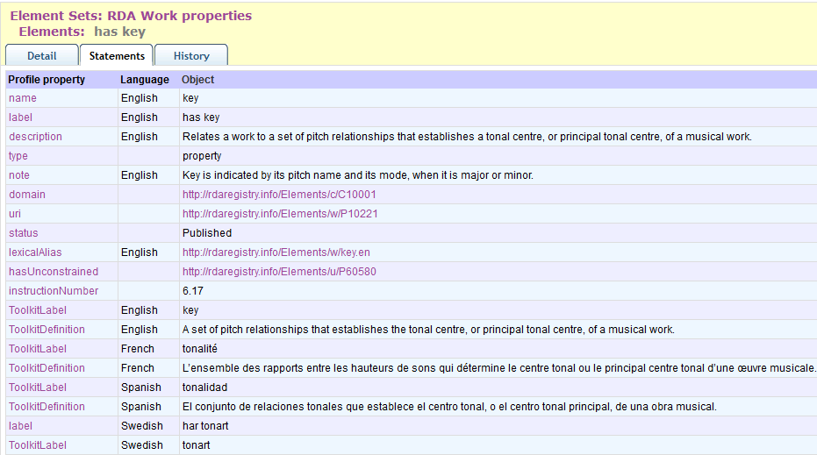
OMR Example

Slide 32
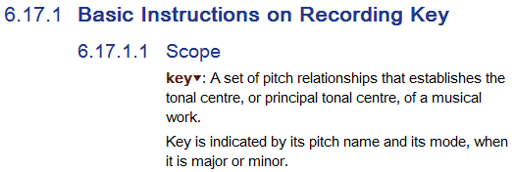
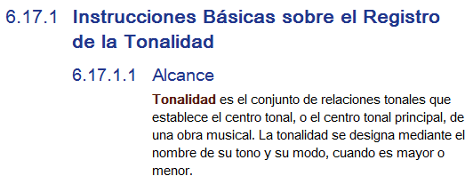
OMR in the RDA Toolkit (just English for now)
Notes:
6.17.1.1 from April 2016 in English:
Scope
Key▼ is the set of pitch relationships that establishes the tonal centre, or principal tonal centre, of a musical work. Key is indicated by its pitch name and its mode, when it is major or minor.

Slide 33
Linked Data: Cataloging Mindset
No longer cataloging for users directly
Instead, you’re cataloging for machines that
Need to understand your data
Respond intelligently to queries from users
Based on what the machine knows about the things you cataloged
Can happen at any future point in time, from a wide variety of locations, cultures, etc.
Create “statements”, not “records”
Integrate vocabularies beyond RDA as needed

Slide 34
Linked Data: Roles
Publisher
Create linked data in your system
Publish it on the open web
Subscriber
Harvest data from the open web
Integrate the data into your system
Likely no monolithic source of linked data that is queried in real time

Slide 35
Linked Data: Risks
Failure of a machine to understand the data
Incompatible vocabularies
Undefined vocabularies
Inappropriate vocabularies
Inappropriate, incomplete, invalid data
Link rot
No published linked data ever goes away, even if it’s wrong
But, new assertions can be made, provenance provided, etc.

Slide 36
Q&A Time
Notes:
What worked, didn’t work
What suggestions do you have for improvement
Where did you struggle

Slide 37
THANK you!!

